Slide 1
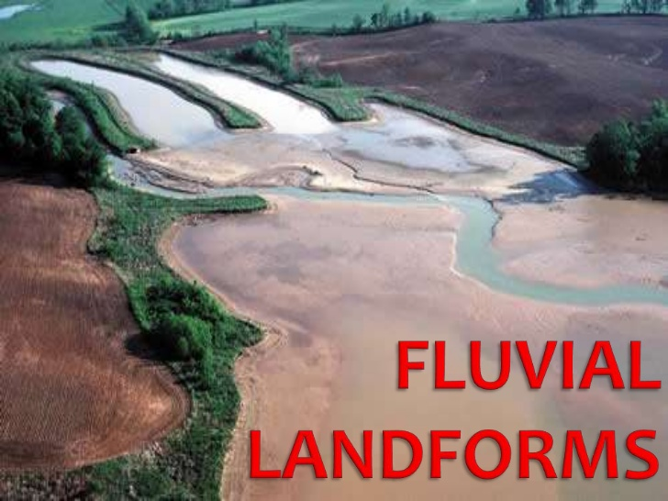

Slide 2
The work of running water in the form of surface runoff or overland flow and stream is most important of all the exogenetic or planation processes (e.g. groundwater, sea waves, glacier, wind, periglacial processes etc.) because the running water is the most widespread exogenetic process on this planet earth.
The landforms either carved out (due to erosion) or built up (due to deposition) by running water are called fluvial landforms (both erosion and depositional features) and the running water which shape them are called fluvial process which include overland flow (surface runoff and stream flow).

Slide 3
The erosional work of the rivers depends on channel gradient, volume of water, velocity and thus kinetic energy, water discharge, sediments load (tools of erosion) etc.
The sediments load of the rivers includes gravels, sands, silt and clay.
The quantity, size and angularity of erosional tools (river load) largely control the nature and magnitude of fluvial erosion.

Slide 4
TYPES OF FLUVIAL EROSION
The erosional work of the rivers performed in two ways (1). Through chemical erosion and (2). Mechanical erosion.
Chemical erosion involves corrosion or solution and carbonation while mechanical erosion comprises corrasion or abrasion, hydraulic action and attrition.
Fluvial erosion is also divided into (1). Vertical erosion or downcutting ( which leads to valley deepning) and lateral erosion (which causes valley widening).

Slide 5
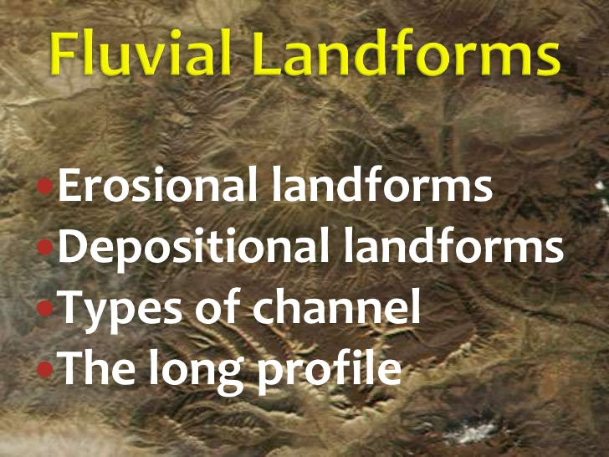

Slide 6
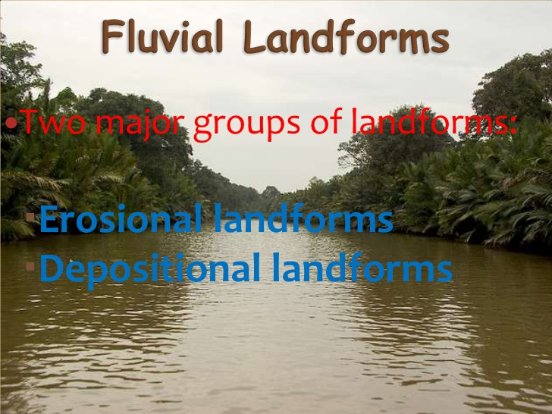

Slide 7
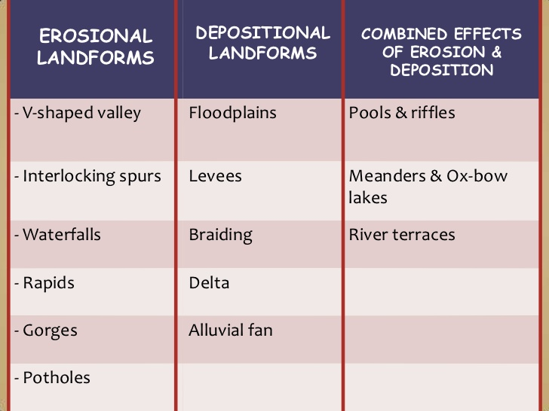

Slide 8
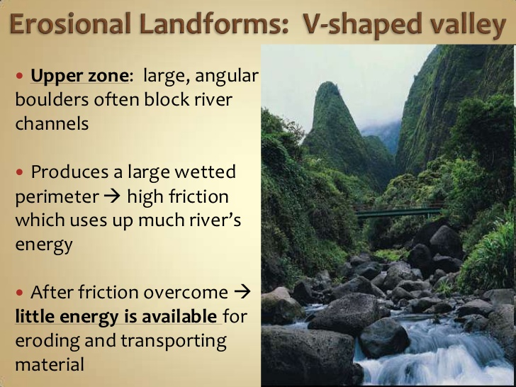

Slide 9
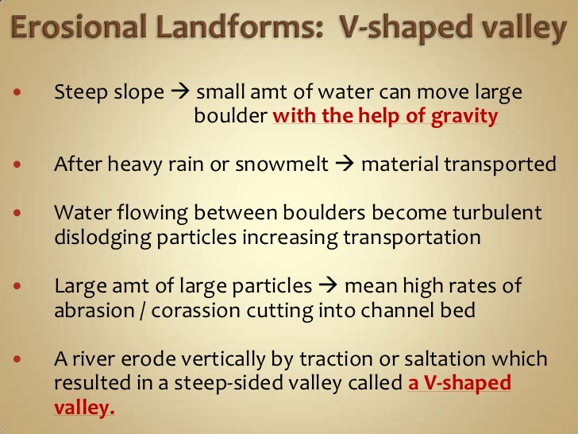

Slide 10
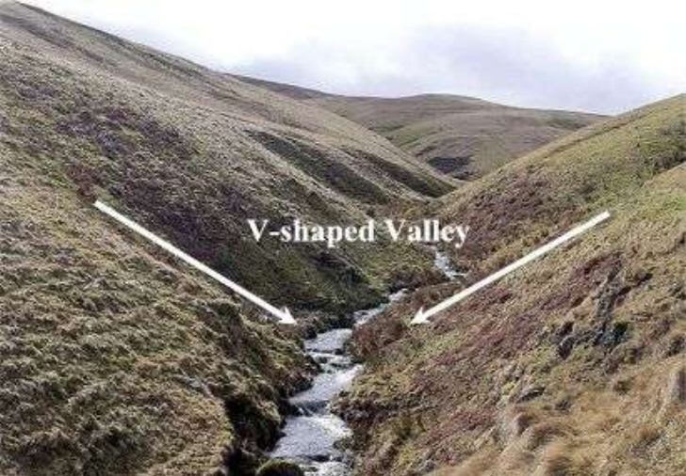

Slide 11
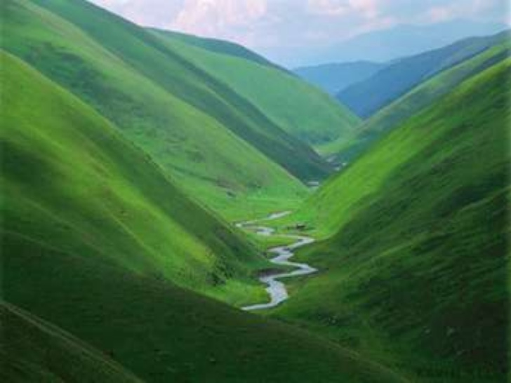

Slide 12
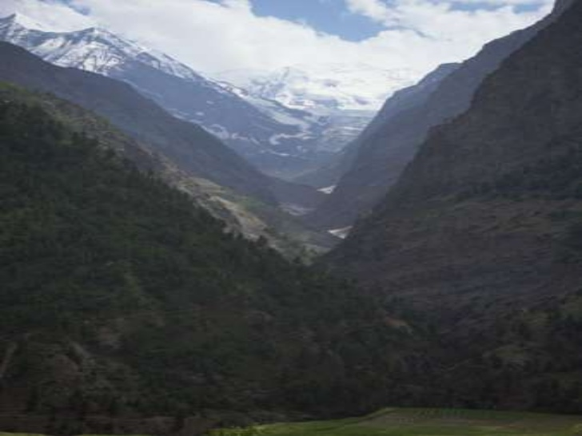

Slide 13
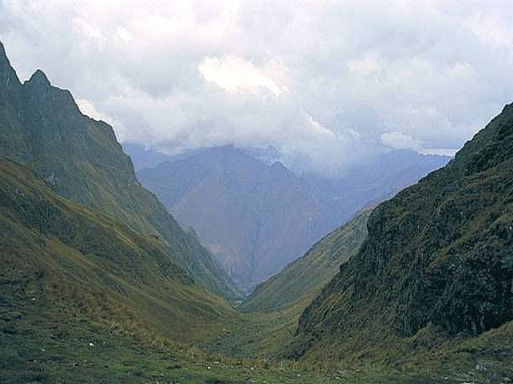

Slide 14
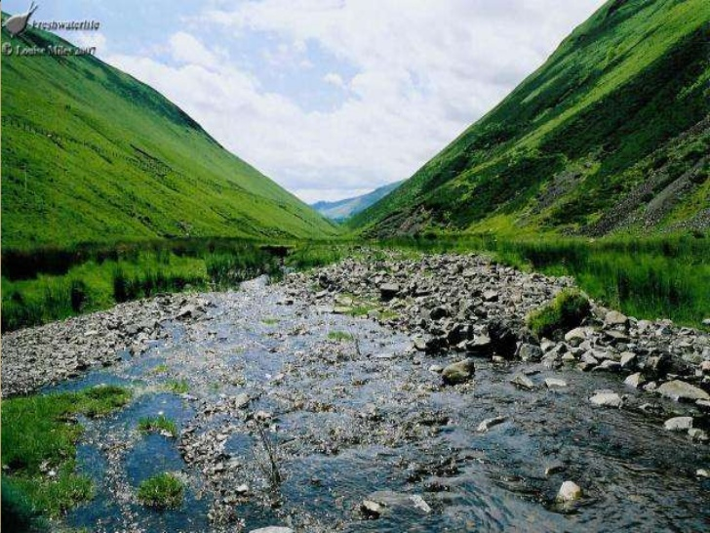

Slide 15
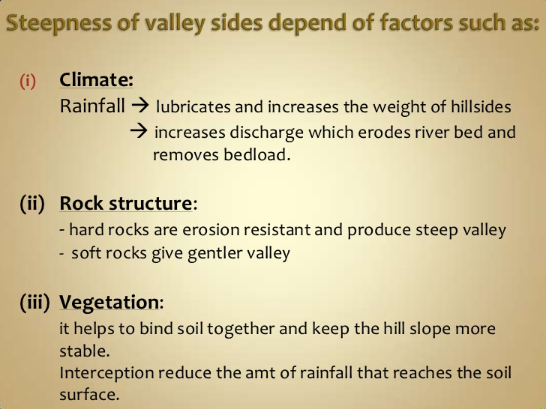

Slide 16
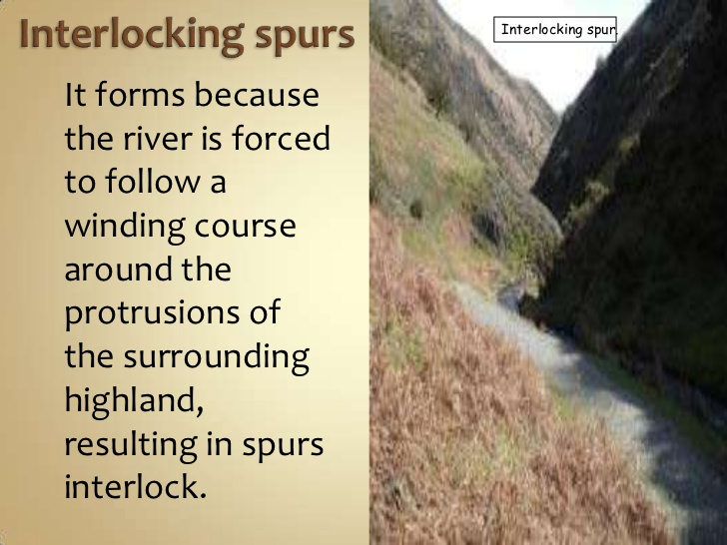

Slide 17
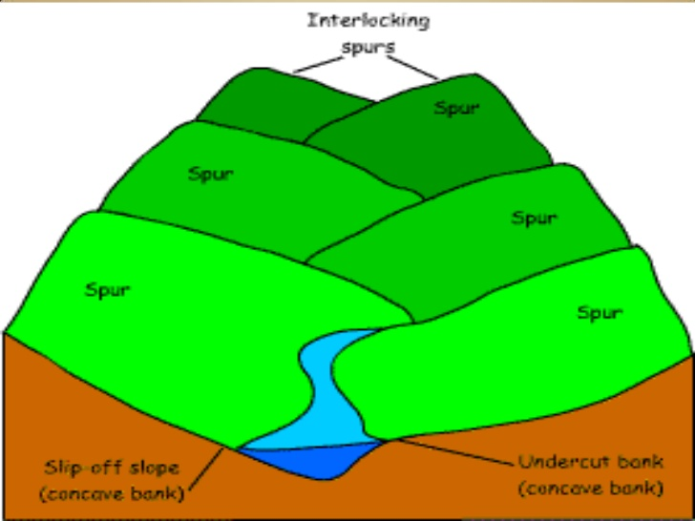

Slide 18
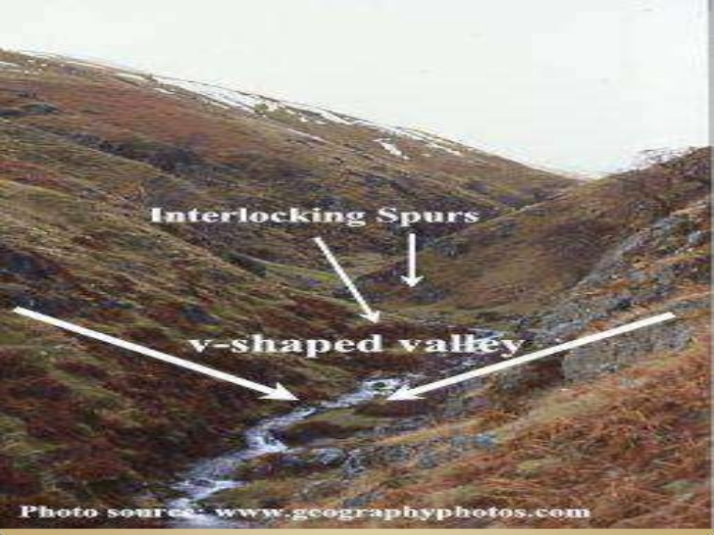

Slide 19
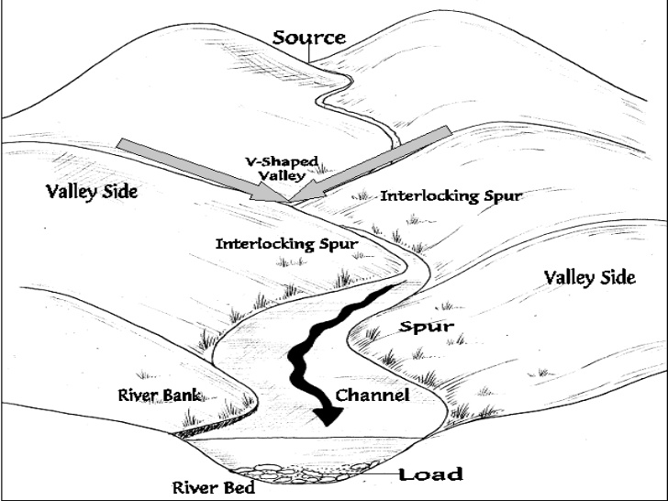

Slide 20
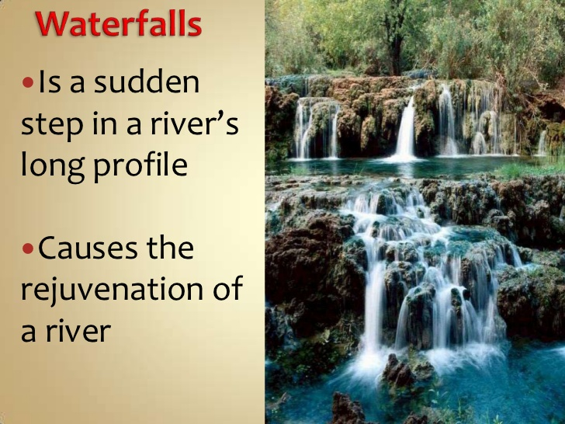

Slide 21
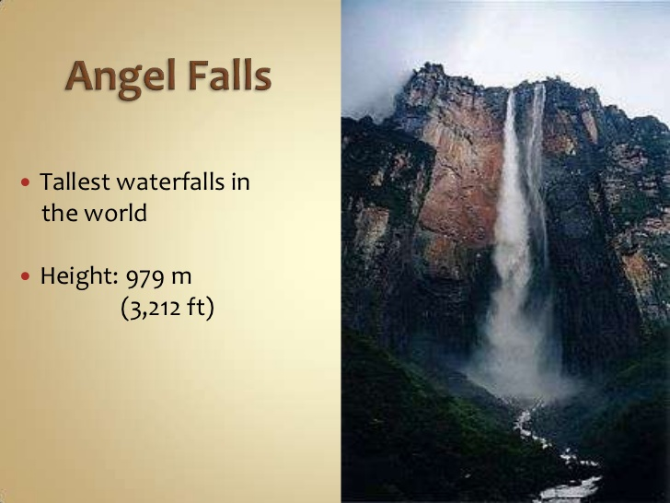

Slide 22
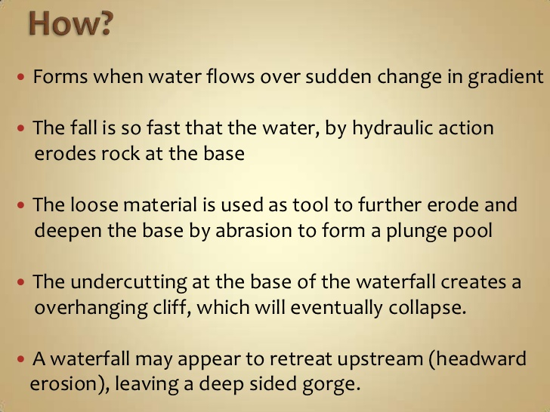

Slide 23
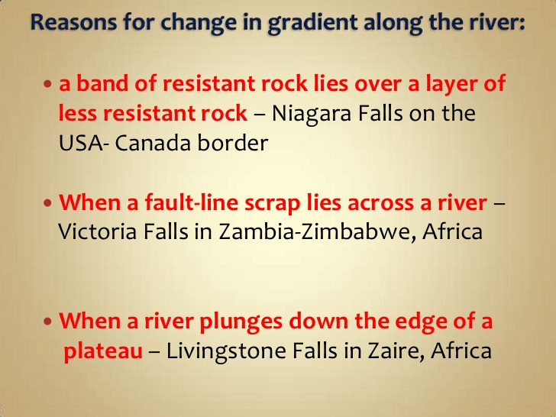

Slide 24
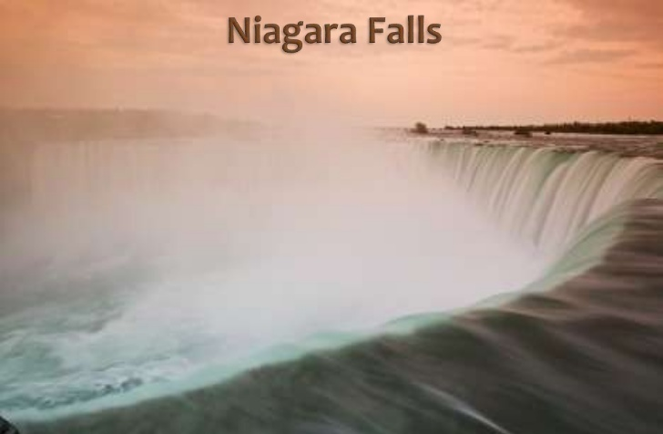

Slide 25
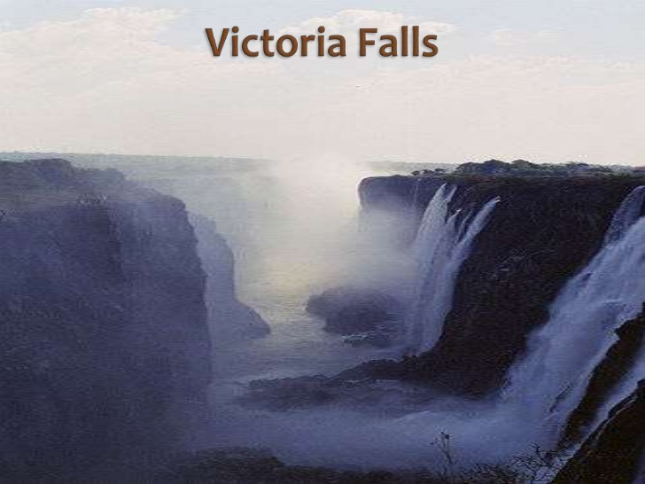

Slide 26
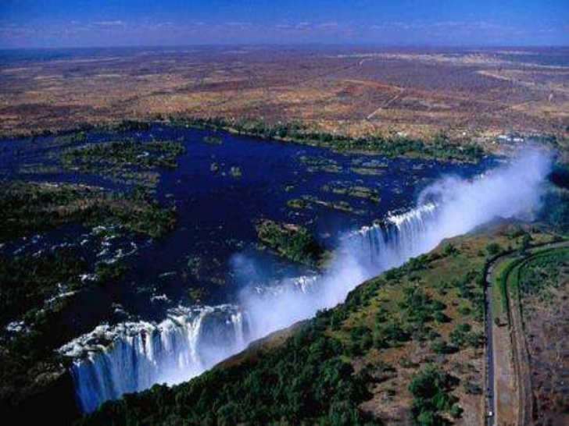

Slide 27
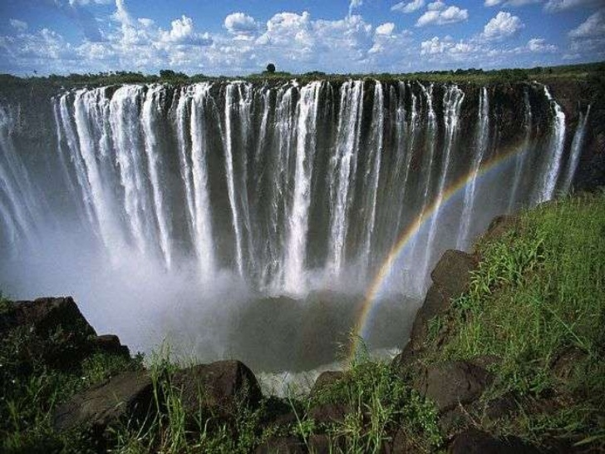

Slide 28
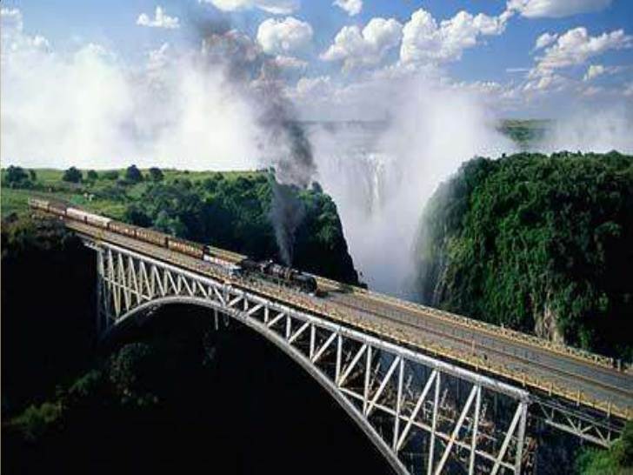

Slide 29
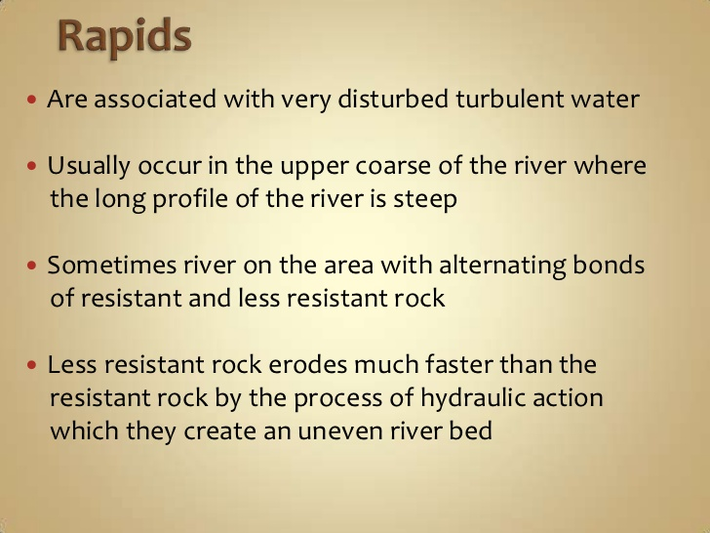

Slide 30
RIVER MEANDERS
River meanders refers to the bends of longitudinal courses of the rivers. The bends of sinous (having many curve and bend) rivers have been named meanders on the basis of meander river of Asia minor (Turkey) because it flow through numerous bends.
The shape of the meanders is usually semi-circular but some time it is also circular.

Slide 31
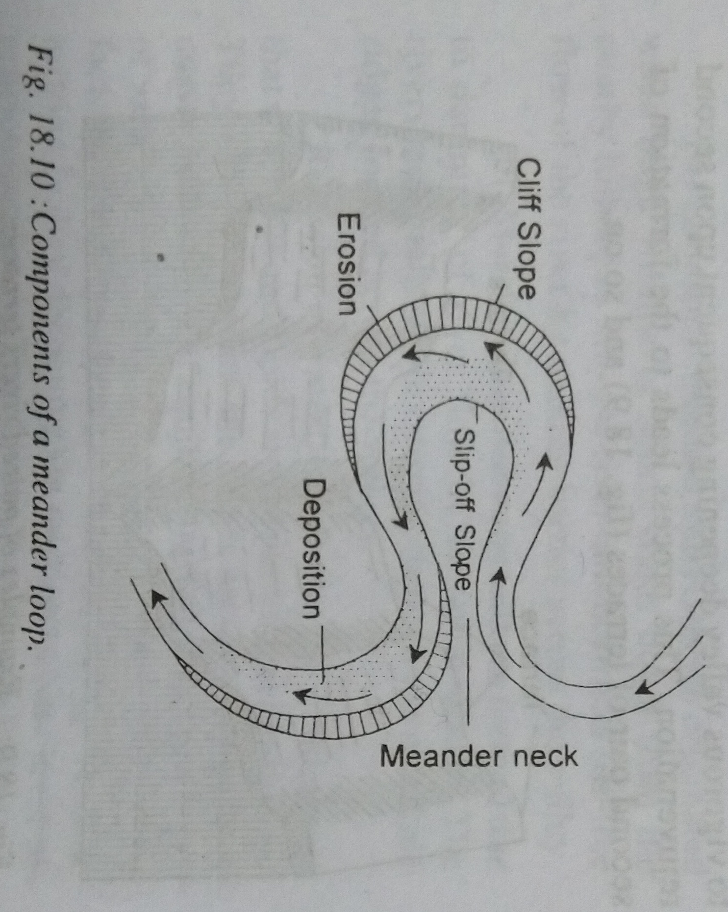
Meander loop

Slide 32
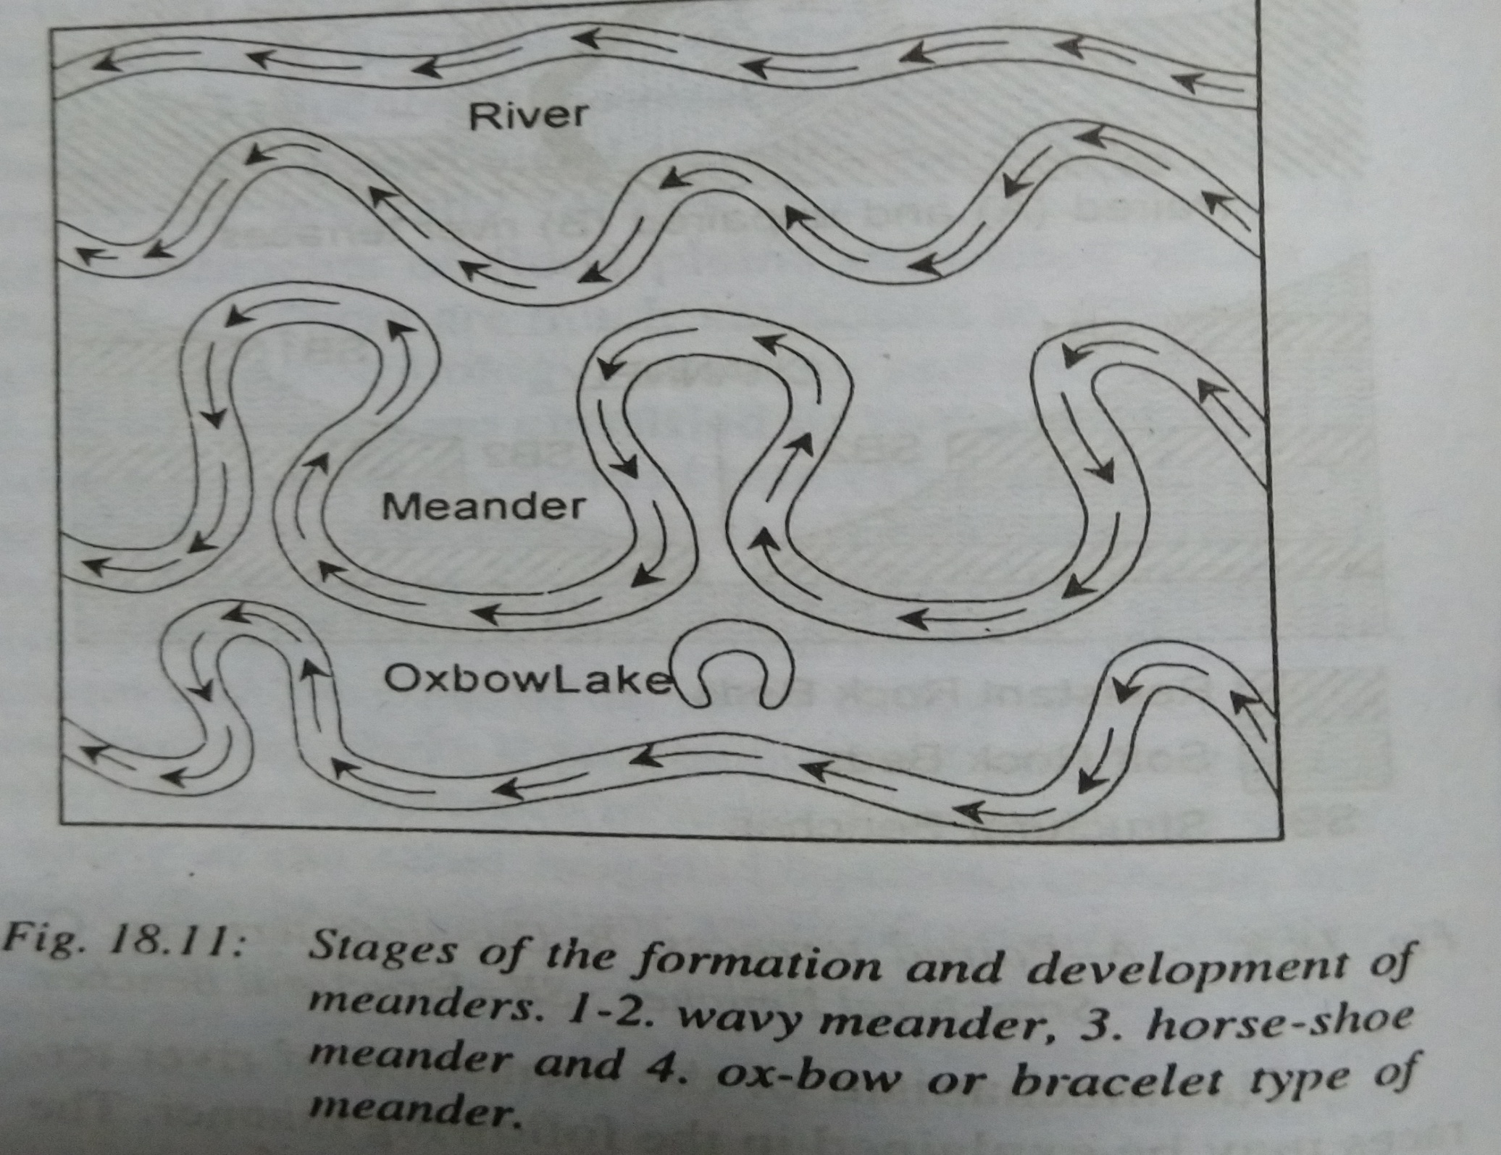

Slide 33
OX- BOW LAKES
The lakes formed due to impounding of water in the abandoned meander loops are called ox-bow or horse-shoe lakes. When the curvature of the meander loops so accentuated due to lateral erosion, the meanders loops become almost circular and the two ends of meander loops come closer, consequently, the streams straighten their courses and meanders loops are abandoned to form ox-bow lakes.

Slide 34
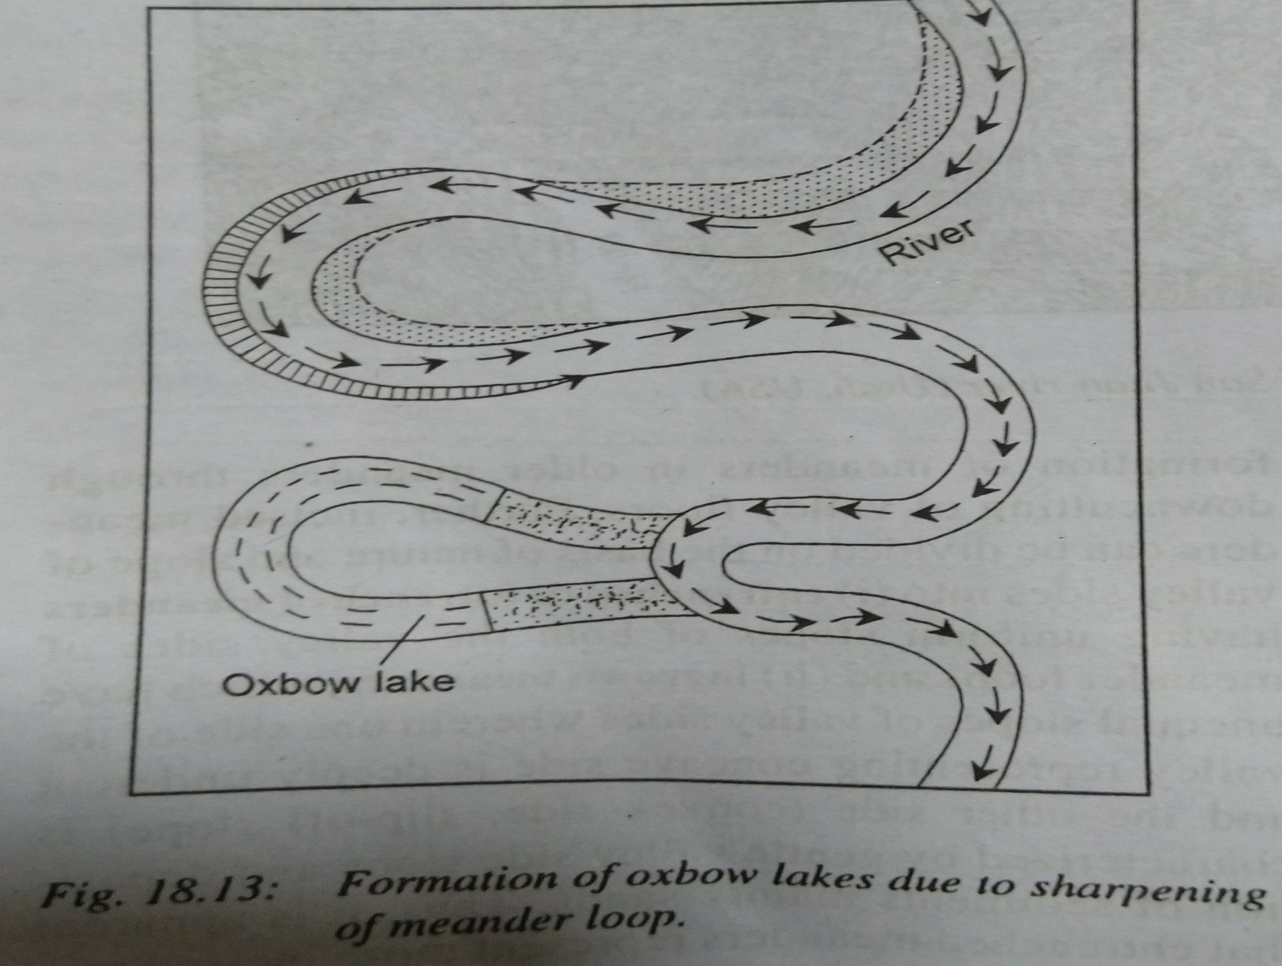

Slide 35
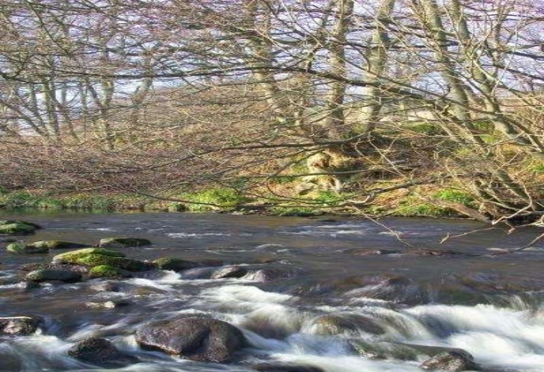

Slide 36
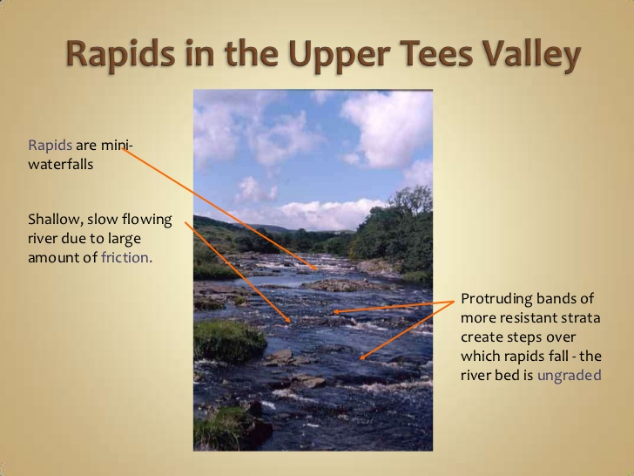

Slide 37
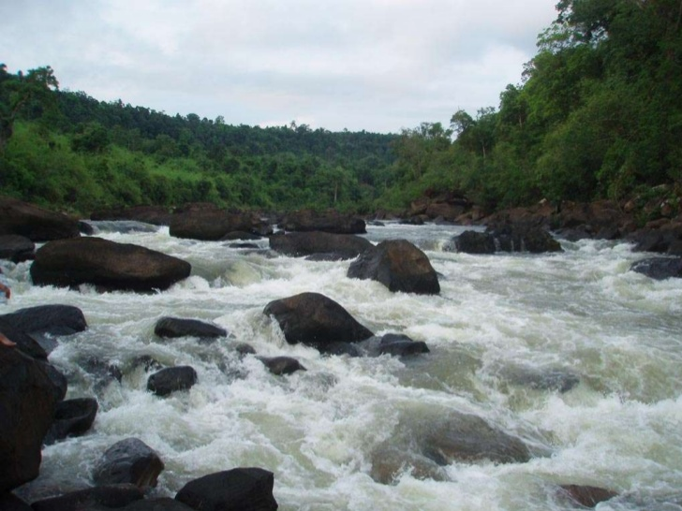

Slide 38
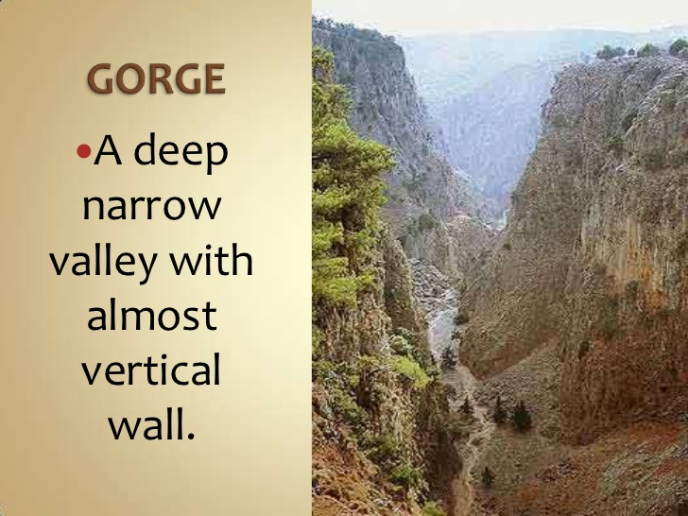

Slide 39
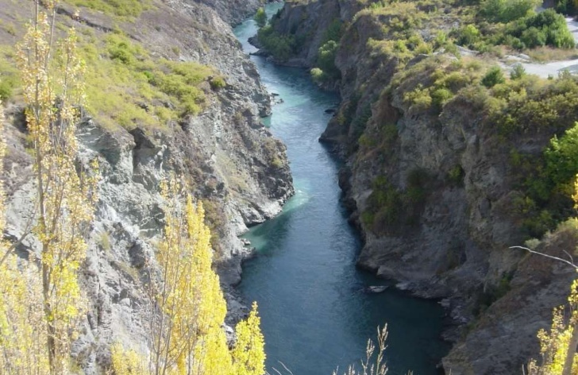

Slide 40
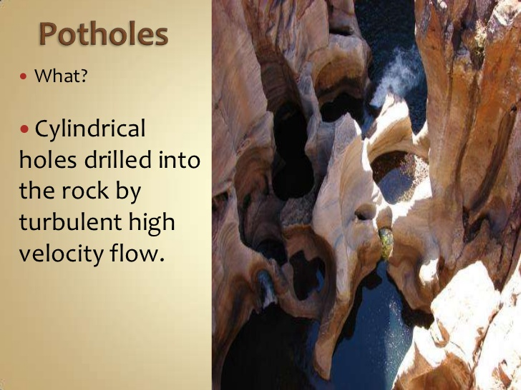

Slide 41
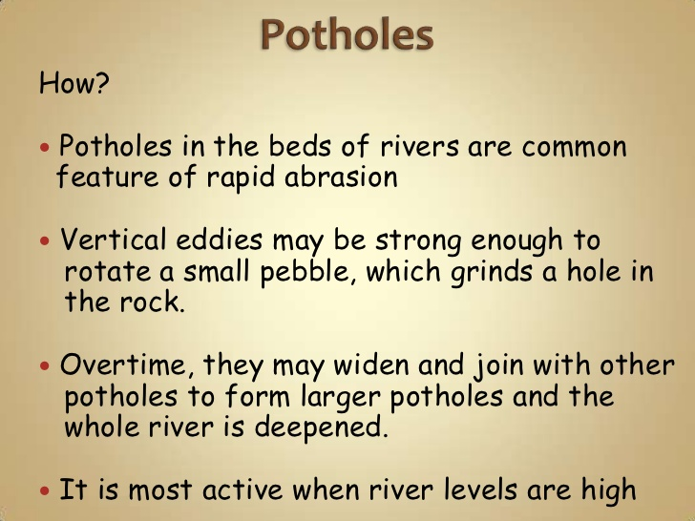

Slide 42
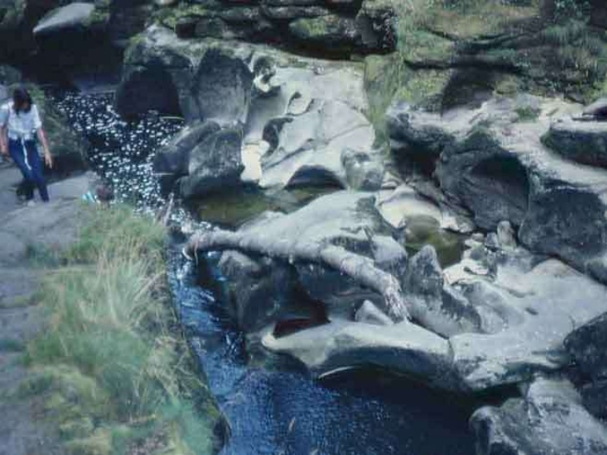

Slide 43
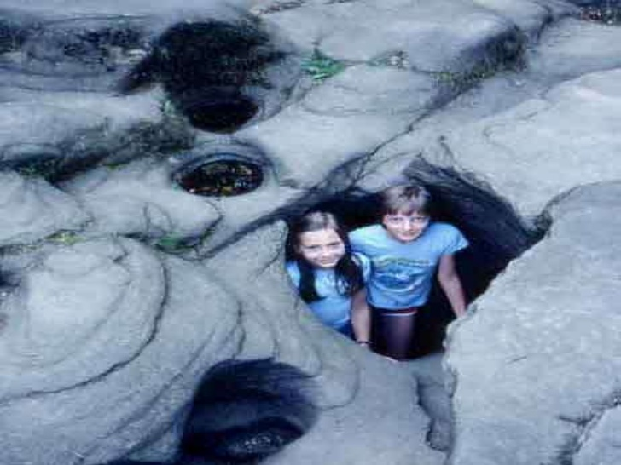

Slide 44
DEPOSITIONAL WORKS OF STREAMS
The deposition of load carried by the streams is effected by a variety of factors,
Like, Decrease in channel gradient, spreading of stream water over larger area, obstruction in channel flow, decrease in the volume and discharge of water, decrease in the velocity of streams, increase in the load etc.
It may be pointed out that aforesaid factors of river deposition may be grouped into two categories
1). Decrease in stream velocity
2). Increase in river load

Slide 45
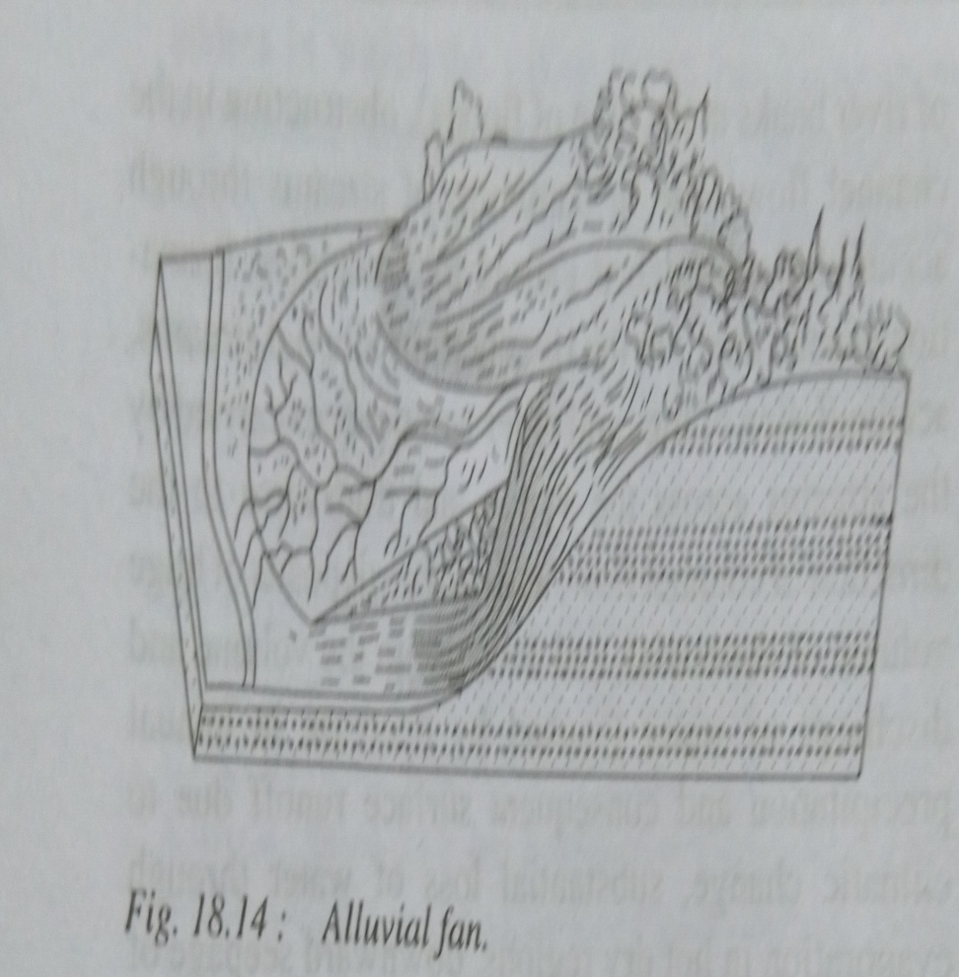
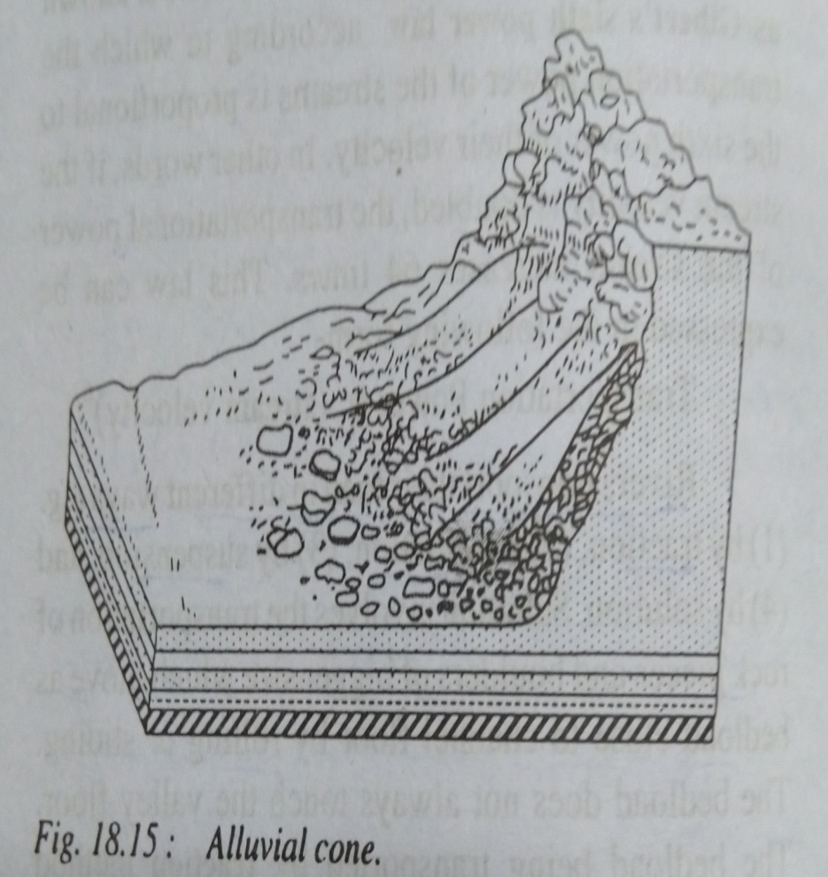
Depositional landforms
1) Alluvial fans and cones

Slide 46
Natural Levees
The narrow belt of ridges of low height built by the deposition of sediments by the spill water of the stream on its either bank is called natural levee or natural embankment.
It may be pointed out that not all the streams build natural levees. Levees are formed due to deposition of sediments during flood periods when the water overtops the river banks and spreads over adjoining flood plains.
The narrow belt of ridges of low height built by the deposition of sediments by the spill water of the stream on its either bank is called natural levee or natural embankment.
It may be pointed out that not all the streams build natural levees. Levees are formed due to deposition of sediments during flood periods when the water overtops the river banks and spreads over adjoining flood plains.

Slide 47
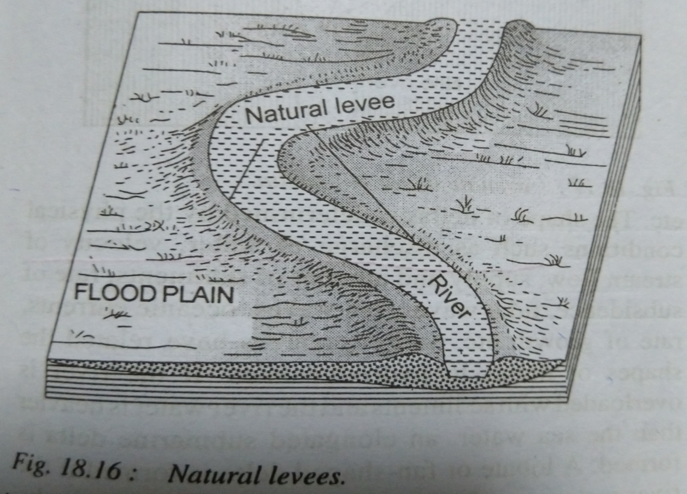

Slide 48
DELTA FORMATION
The formation of delta starts with the formation of sediments if the aforesaid favourable conditions are available.
The sedimentation takes place regularly at the mouth of the river, on the side of stream channel, in the bed of the river and in front of river mouth where the river debouches in the sea.

Slide 49
